Slide 1


Intro to H2O.ai
Spice Up VIS with Machine Learning
IEEE VIS 2016 // Baltimore, DC
Lauren DiPerna // Open-Source Data Scientist
Ivy Wang // User Experience Designer

Slide 2
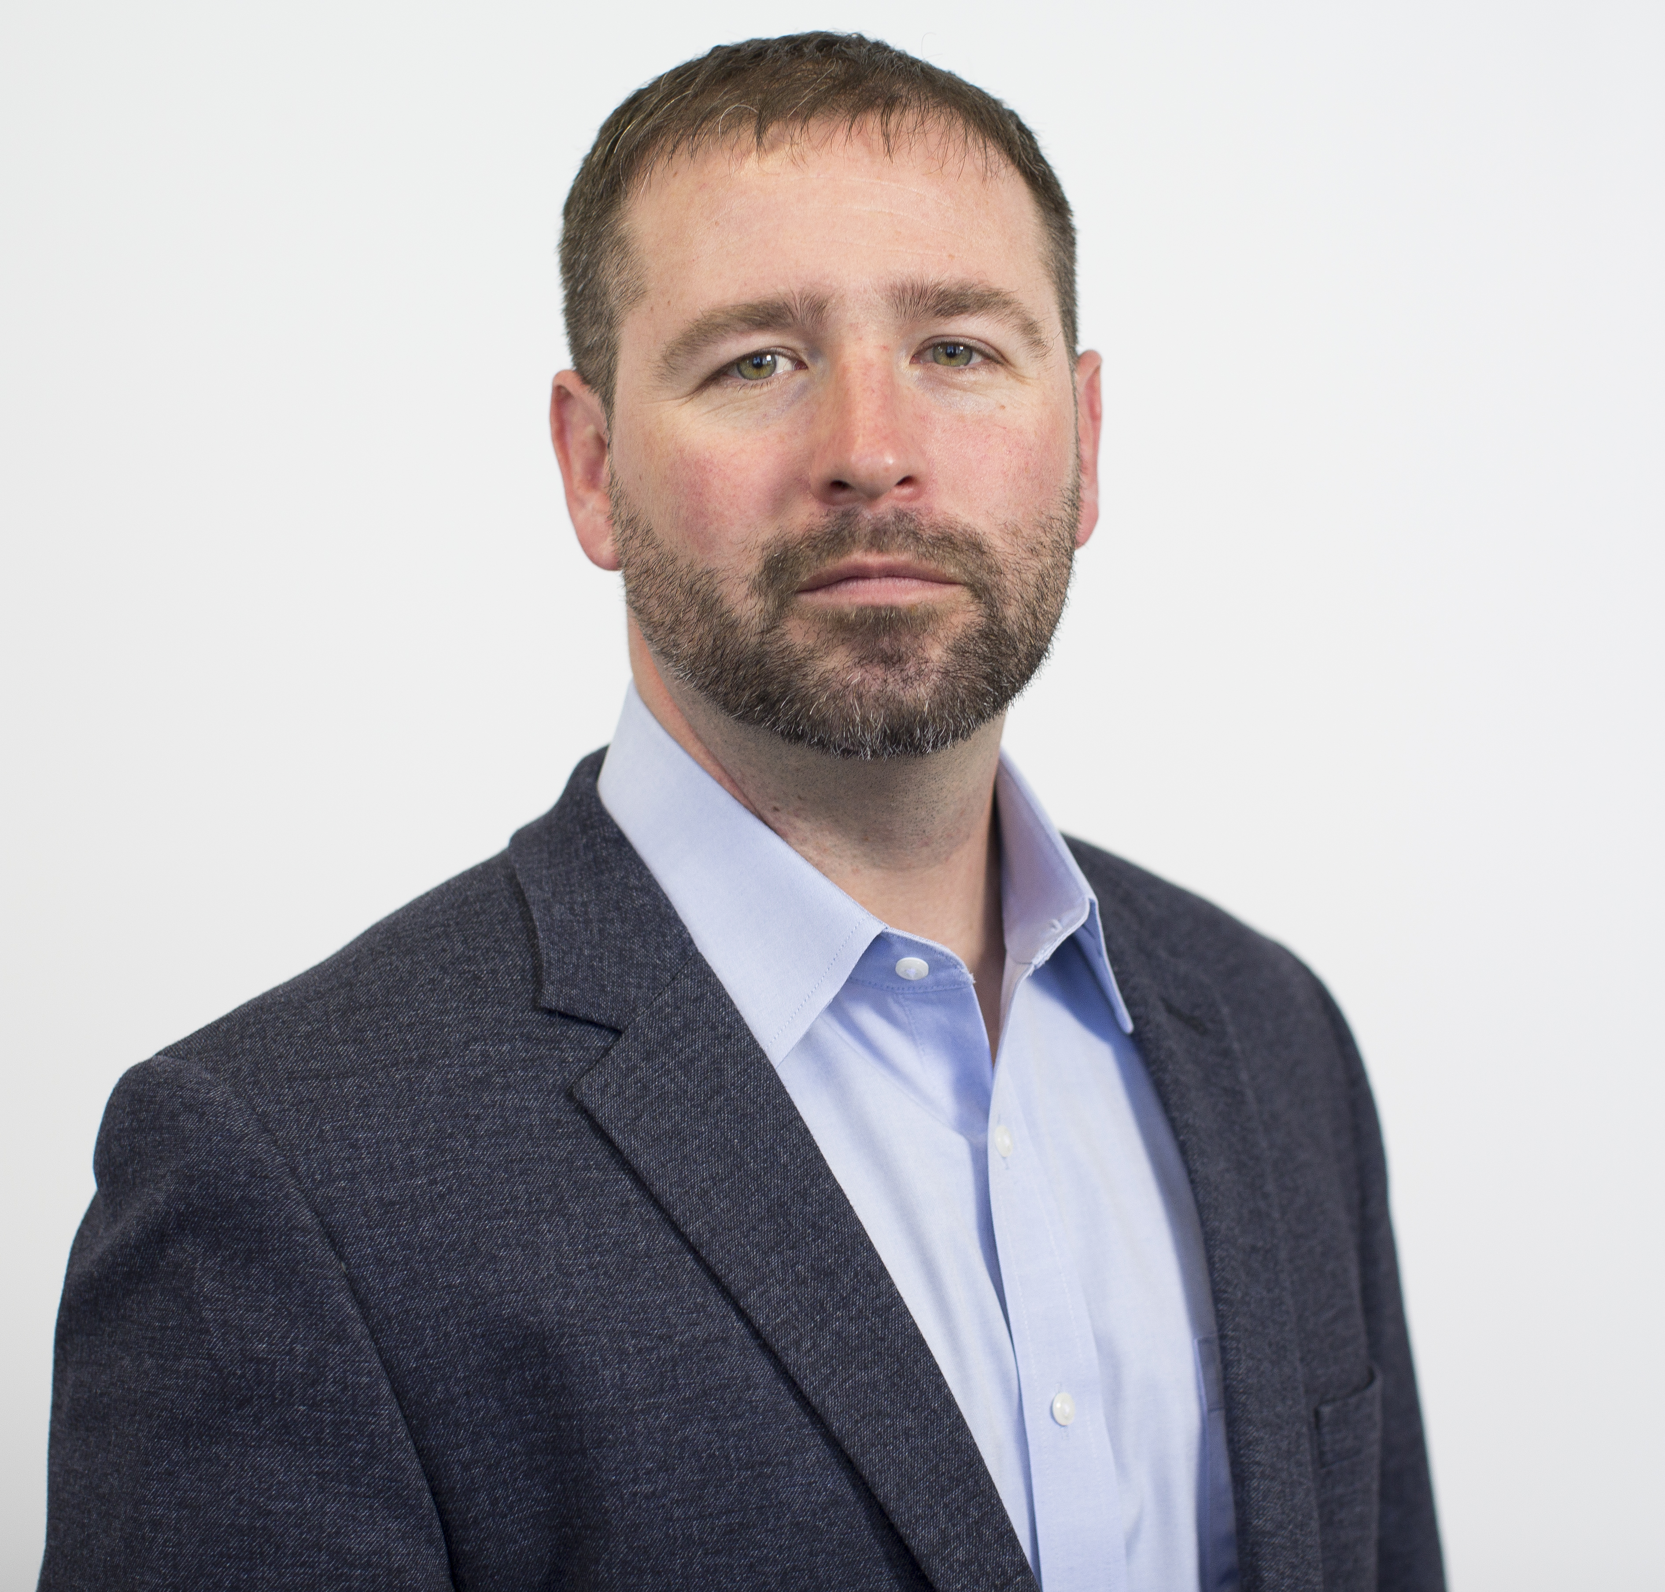
Leadership Team
Sri Ambati
CEO & Co-Founder
Datastax & Platfora
Tom Krajlevic
VP, Customer Engineering
Abrizio, Intel
Arno Candel
Chief Architect
CERN, SLAC, Skytree
Josephine Wang
VP, Sales
Teradata, SAS
Scott McClellan
VP, Data Alliances & Ecosystems
Red Hat, HP
Jon Oslowski
CFO
Datameer, CBIZ/MHM
Bill Gallmeister
VP, Engineering
Sun, Azul Systems
Leland Wilkinson
Chief Scientist
“The Grammar of Graphics”
Betty Candel
VP, Marketing
SkyTree, SafeNet
Avkash Chauhan
VP, Customer Support

Slide 3

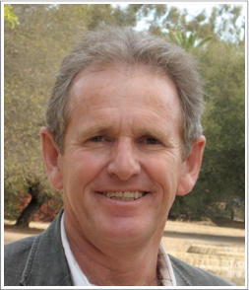
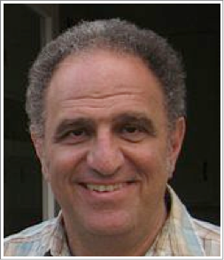
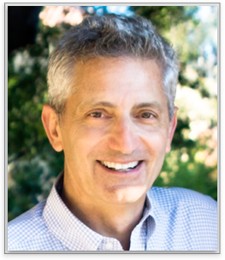
cientific Advisory Council
Dr. Trevor Hastie
PhD in Statistics, Stanford University
John A. Overdeck Professor of Mathematics, Stanford University
Co-author, The Elements of Statistical Learning: Prediction, Inference and Data Mining
Co-author, Generalized Additive Models
108,404 citations (via Google Scholar)
Dr. Robert Tibshirani
PhD in Statistics, Stanford University
Professor of Statistics and Health Research and Policy, Stanford University
COPPS Presidents’ Award recipient
Co-author, The Elements of Statistical Learning: Prediction, Inference and Data Mining
Author, Regression Shrinkage and Selection via the Lasso
Co-author, An Introduction to the Bootstrap
Dr. Steven Boyd
PhD in Electrical Engineering and Computer Science, UC Berkeley
Professor of Electrical Engineering and Computer Science, Stanford University
Co-author, Convex Optimization
Co-author, Linear Matrix Inequalities in System and Control Theory
Co-author, Distributed Optimization and Statistical Learning via the Alternating Direction Method of Multipliers

Slide 4
OUTLINE
What is this meetup about?
What is Machine Learning?
Why should VIS people care?
Overview of Algos
Hands-on Tutorial
Solve one yourself!

Slide 5
Machine Learning
What is it?
Unlike rules-based systems which require a human expert to hard-code domain knowledge directly into the system, a machine learning algorithm learns how to make decision from the data alone.

Slide 6
Machine Learning
What is it?
THE TASK
THE RESULTS
Training a Model
Predictions
Evaluating the Model
Classification
Ranking
Recommendation

Slide 7
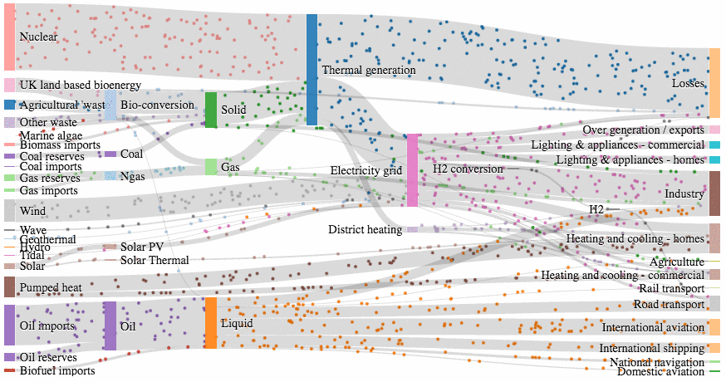
Why should VIS people care?
Interactive Data Analysis / VA
Interpretability
Story-telling

Slide 8
Why H2O for ML?
more data + more models = better predictions
Cutting-Edge Algorithms
Big Data
Cutting-edge ML Algos
Deep Learning & Ensembles
Nano Fast Scoring Engine
Scale to Big Data
Access Data links
Use all data without sampling
Speed Matters
Easy To Use
In-memory is faster
Distributed is faster
High speed AND accuracy
Interactive Web-Based Modeling
Python, R, Rest, Scala, Java APIs

Slide 9
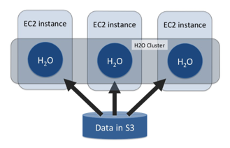
H2O Distributed Computing
In Memory, Distributed Machine Learning Algorithms
Multi-node cluster with shared memory model
All computations in memory
Each node sees only some rows of the data
No limit on cluster size

Slide 10
Type of Problems to Solve
How can H2O.ai help?
Predict The Price of a House
Classify emails
Classify Wines
Regression
Binary Classification
Multi-Class Classification
$
2 classes
3 classes
$
Good or bad
Terrible, good, excellent

Slide 11
Supervised Algos Overview
How can H2O.ai help?
Generalized Linear Model (GLM)
Distributed Random Forest (DRF)
Gradient Boosting Machine (GBM)
Naïve Bayes
Deep Learning (DL)

Slide 12
Algorithm Lookup Table
Which algo do you use?
Algorithm | Binary Classification | Multi-Class Classification | Regression
Generalized Linear Model | Logistic regression: Yes Linear regression: No | Yes | Yes
Gradient Boosting Machine | Yes | Yes | Yes
Distributed Random Forest | Yes | Yes | Yes
Naïves Bayes | Yes | Yes | No
Deep Learning | Yes | Yes | Yes

Slide 13
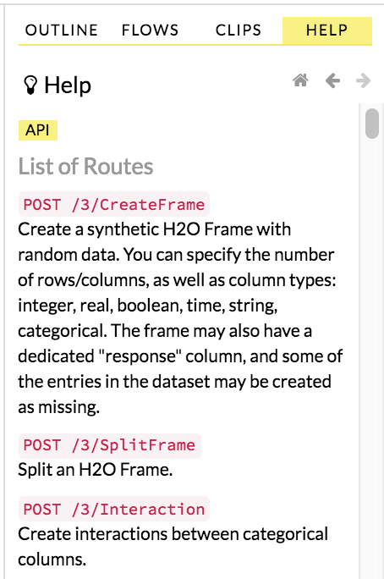
REST APIs
H2O.ai welcomes VIS contributions from community!
H2O Flow
Operations on data manipulation
Training models
Score models
Obtain model metrics

Slide 14
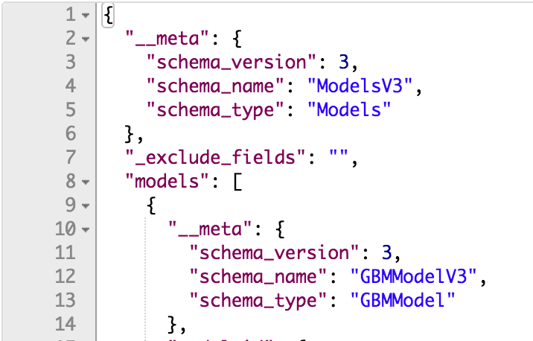
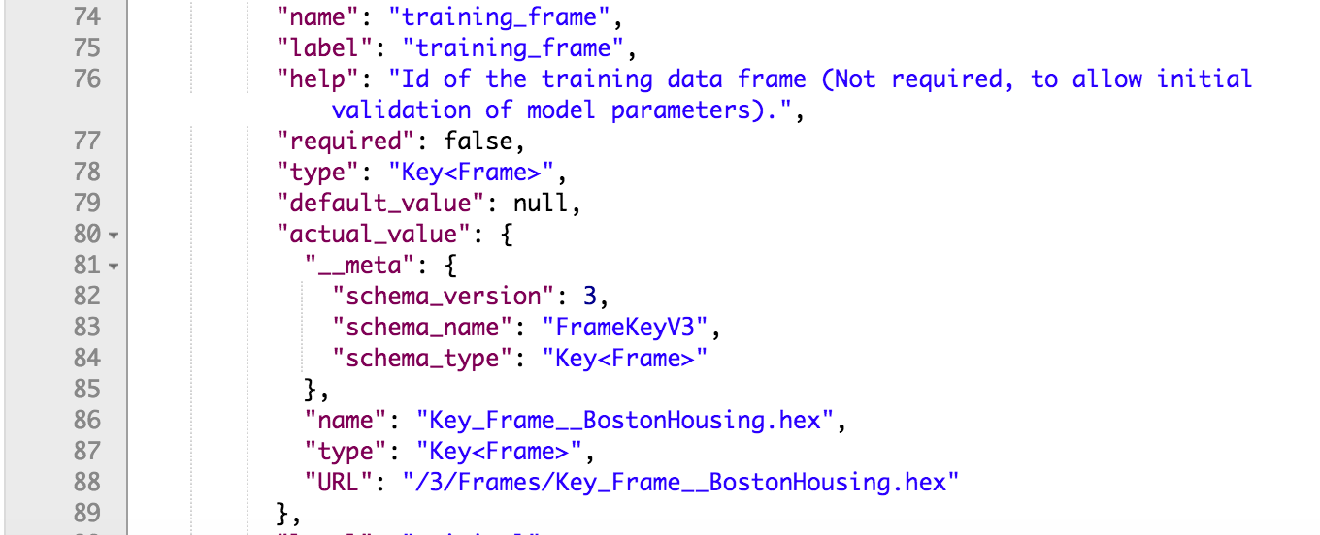
/3/Models/gbm-boston

Slide 15
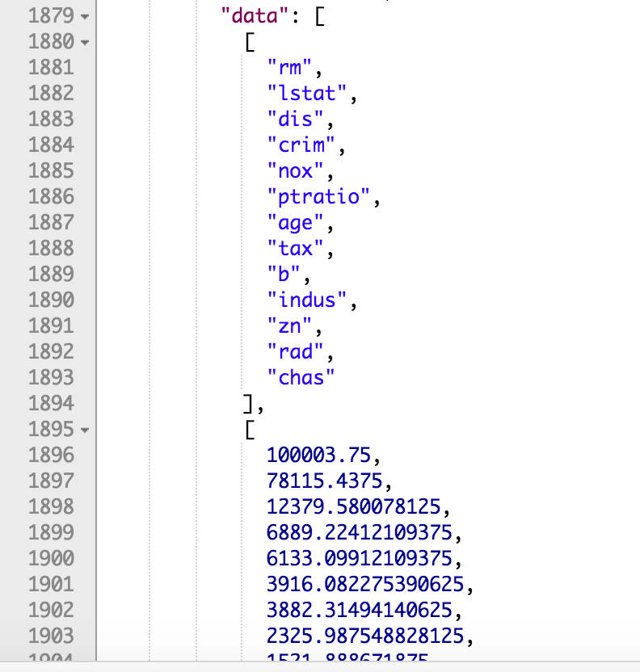
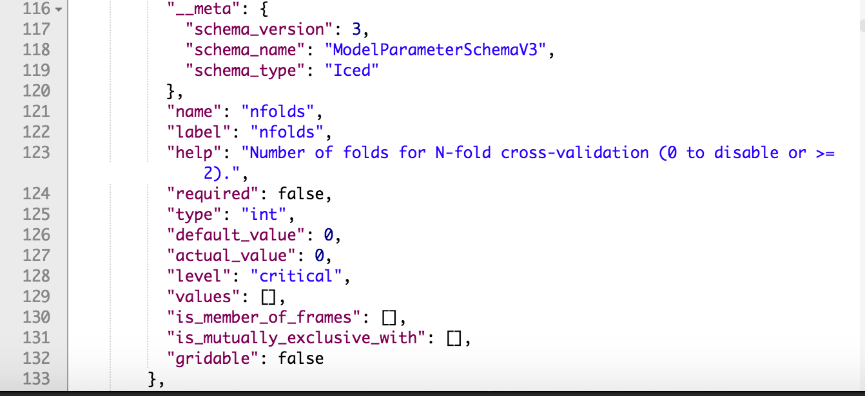
/3/Models/gbm-boston

Slide 16
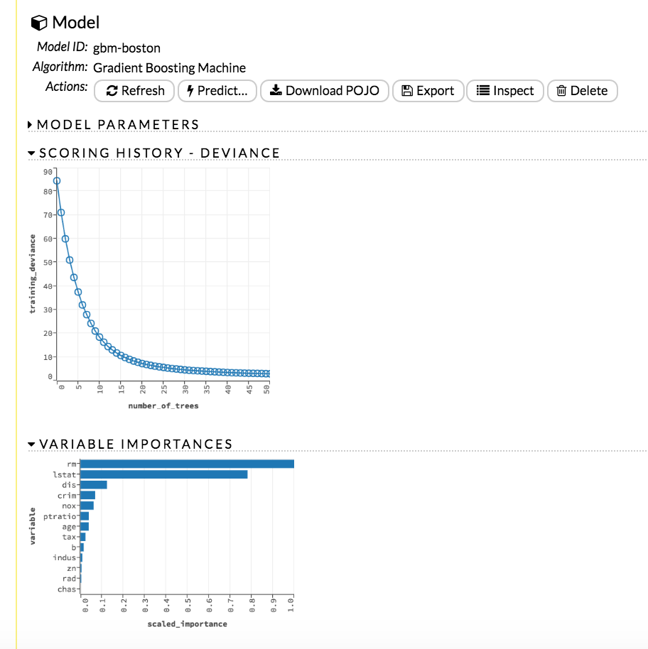

Slide 17
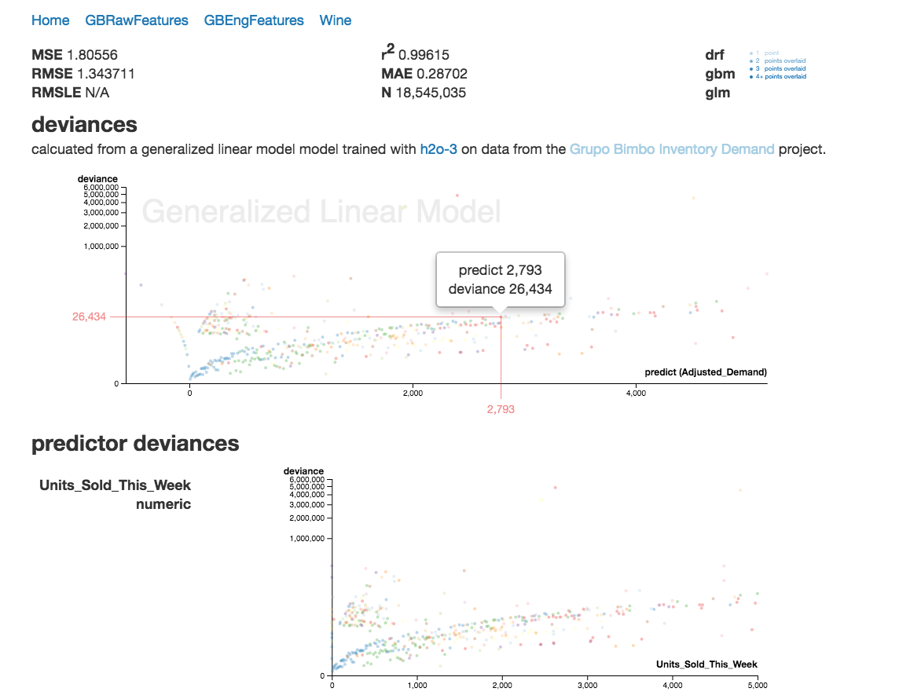
EXAMPLE VIS APP
Partial Deviance Plots

Slide 18
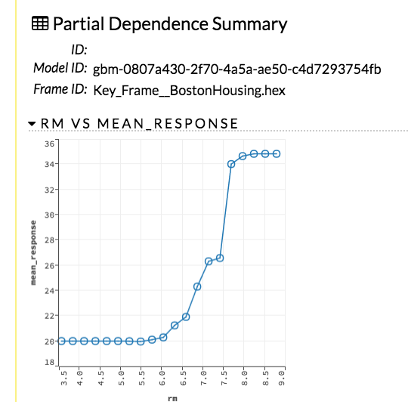
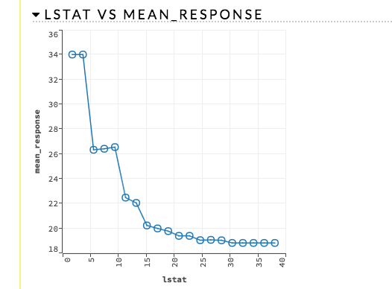
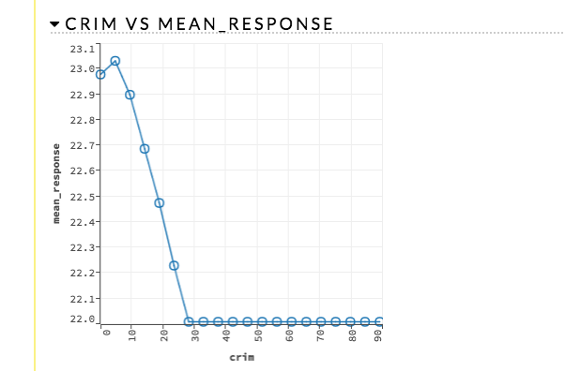
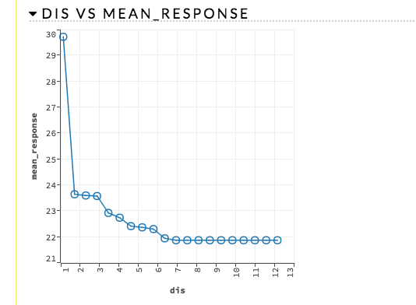
EXAMPLE VIS FEATURE
Partial Dependence Plot

Slide 19
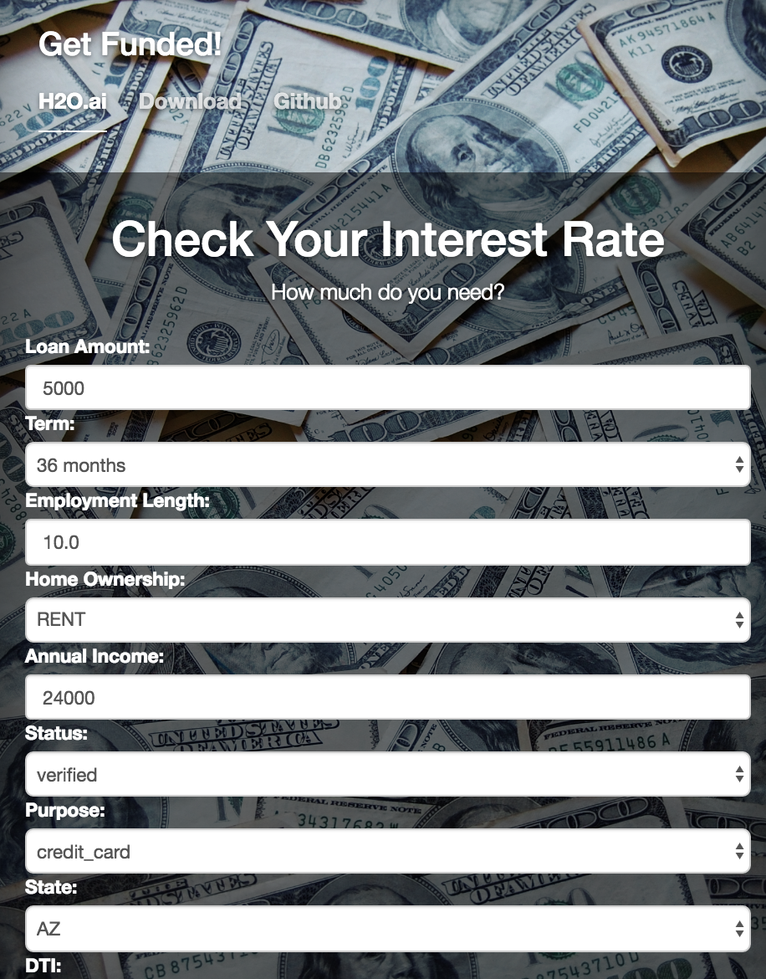
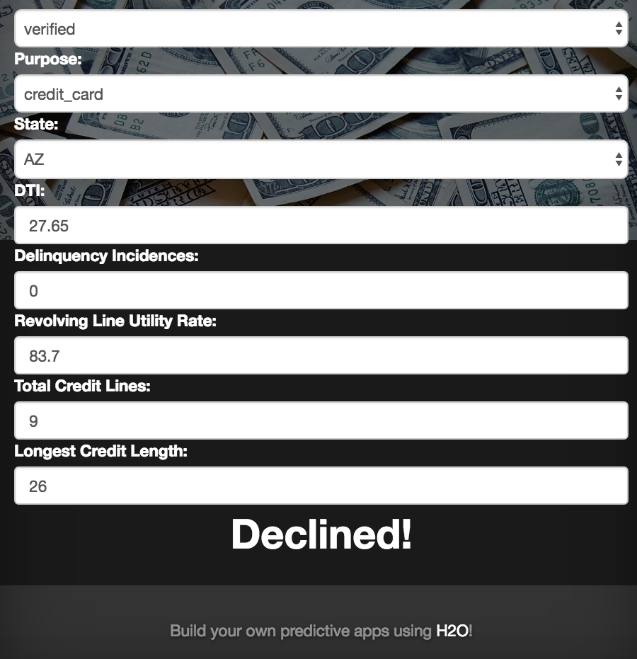
EXAMPLE ML APP
Consumer Loan Predictions

Slide 20
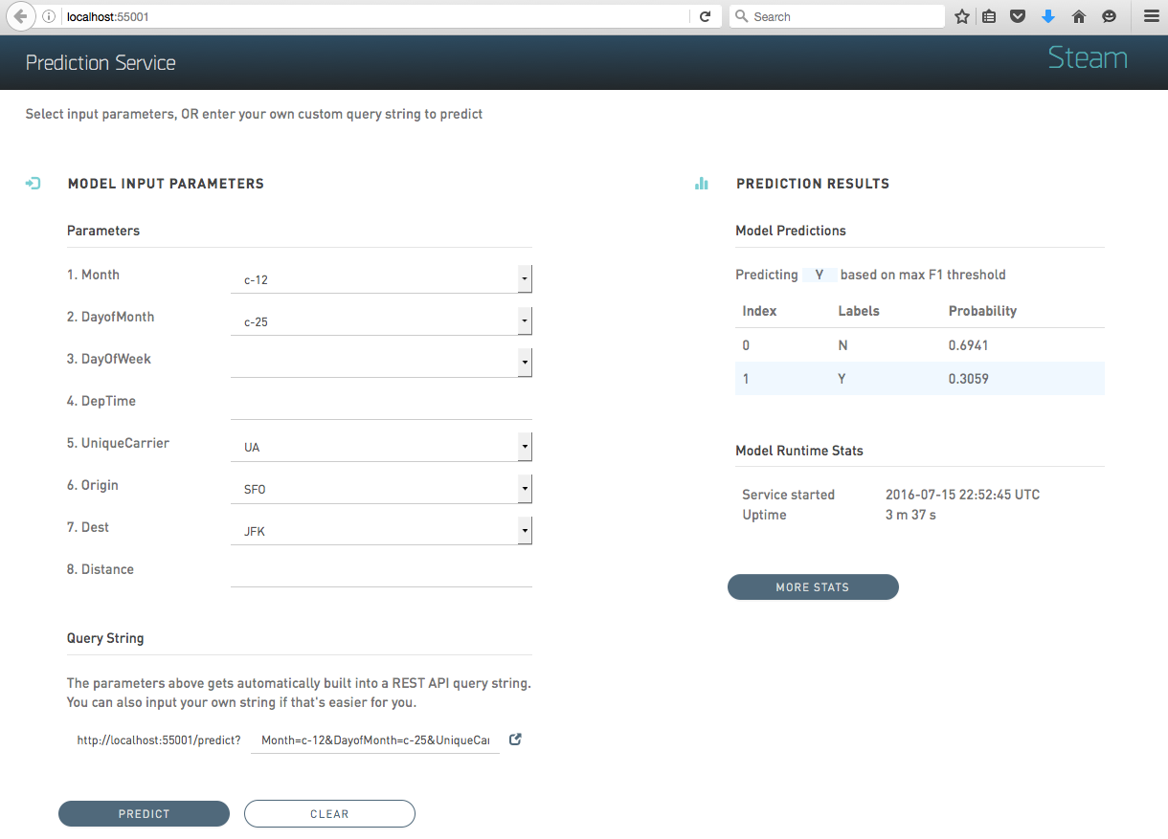
REST APIs
H2O.ai welcomes VIS contributions from community!
H2O Steam
Deploy models on single REST endpoints
Out-of-box UI to help testing predictions

Slide 21
Open Source Love
H2O.ai welcomes VIS contributions from community!
Custom Visualizations
User Research
Talk to us!
Contribute to building useful visualizations for Flow, Python, R APIs
Participate in our user research.
All your good ideas about visualization in ML or anything in general. We love to hear about them!

Slide 22
Want more H2O?
Links & Resources
Learning resources
Ask questions!
Find us online!
Docs, Guides, Tutorials http://docs.h2o.ai
Videos
https://www.youtube.com/user/0xdata
Google Stream
https://groups.google.com/forum/#!forum/h2ostream
Stack Overflow (#h2o)
Gitter
https://gitter.im/h2oai/h2o-3
H2O Community http://community.h2o.ai
Twitter: @h2oai
Github: h2oai

Slide 23
WE ARE HIRING!

Slide 24
Hands-on Tutorial

Slide 25
Installation

Slide 26
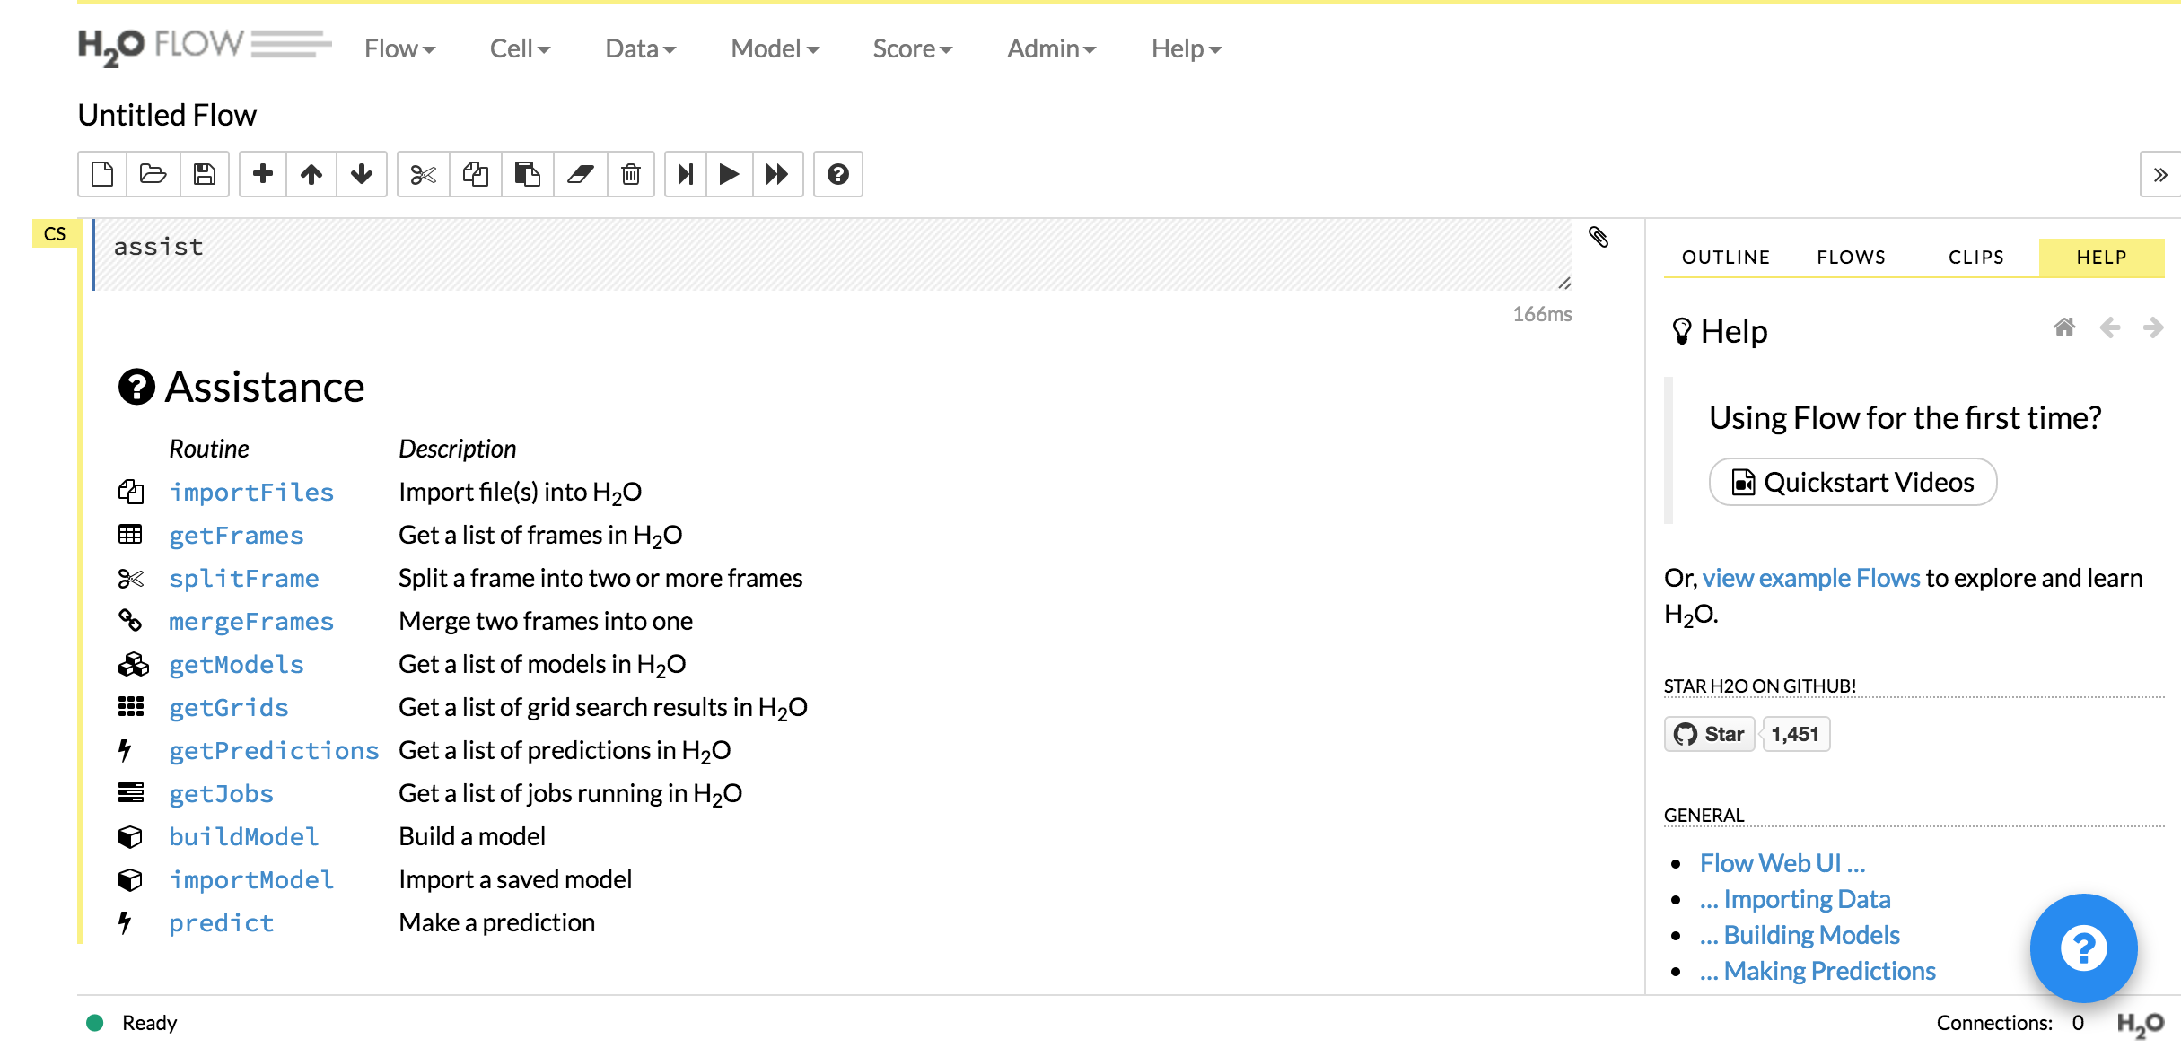
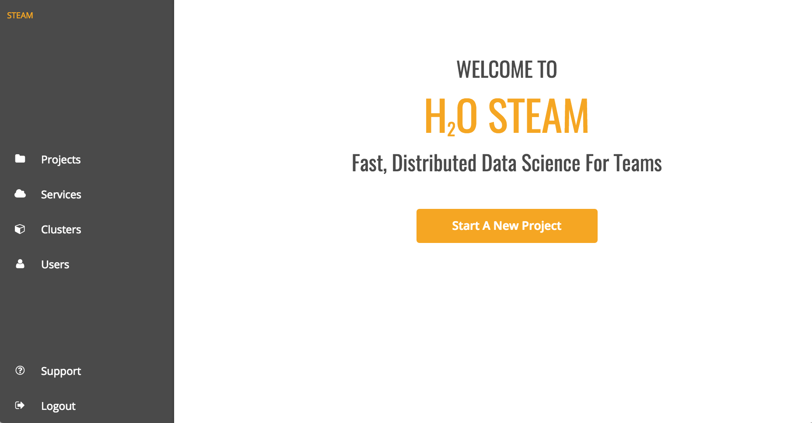
Copy theses folders to your local drive (assuming /Desktop/meetup)
Datasets
OSX
Install and start H2O in Terminal
$ cd ~/Desktop/meetup/OSX
$ unzip h2o-3.10.0.8.zip
$ cd h2o-3.10.0.8
$ java –jar h2o.jar
Open your browser http://localhost:54321
Install and start Steam in Terminal
$ cd ~/Desktop/meetup/OSX
$ tar -xzvf steam-1.1.2-darwin-amd64.tar.gz
$ cd steam-1.1.2-darwin-amd64
$ ./steam-launcher
Open your browser http://localhost:9000
Login using username: superuser, password: superuser

Slide 27
If you don’t already have JDK installed, or don’t know what a JDK is
Goto OSX or Windows folder
Goto Java folder
Use the .dmg or .exe file to install the JDK

Slide 28
Tutorial 1: Wine

Slide 29
Tutorial 2: Airlines

Slide 30
Now try one yourself!

